Slide 1

Sprocket Central Pty Ltd
Data analytics approach
Data Analytics Division –Muhammad Ali A.

Slide 2
Agenda
Introduction
Data Exploration
Model Development
Interpretation

Slide 3
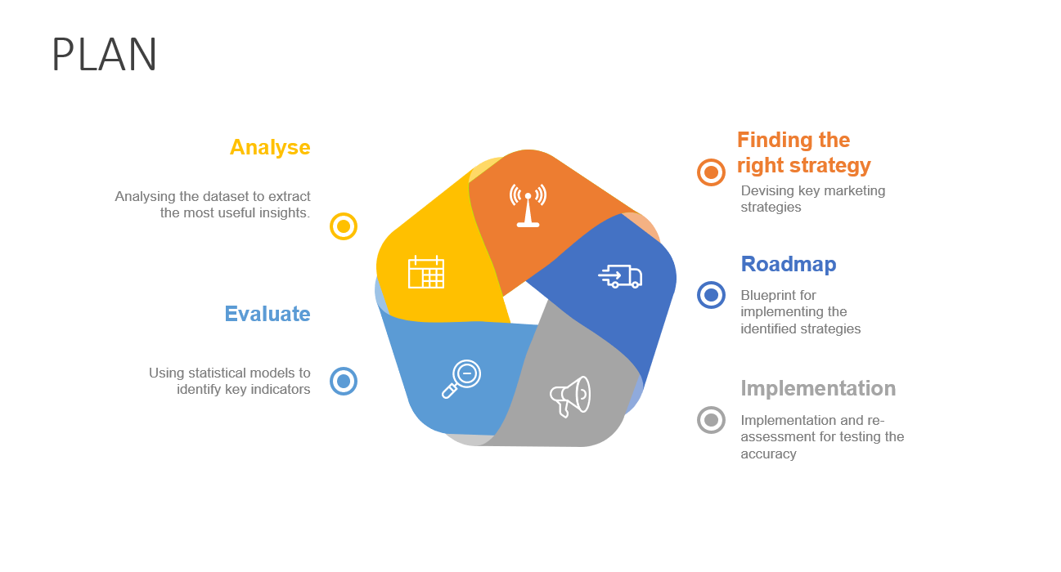
Introduction
The Marketing Strategy
The PLAN diagram explains the process which ensures the accurate process of effectively targeting the new 1000 customers.
Place any supporting images, graphs, data or extra text here.

Slide 4
Data Exploration
The following distributions are used for data exploration as they are they are necessary indicators for finding the right customers
-Age Distribution
-Bike related purchases of past 3 years
-Wealth Segment
-Job industries of customers
-Customer Address

Slide 5
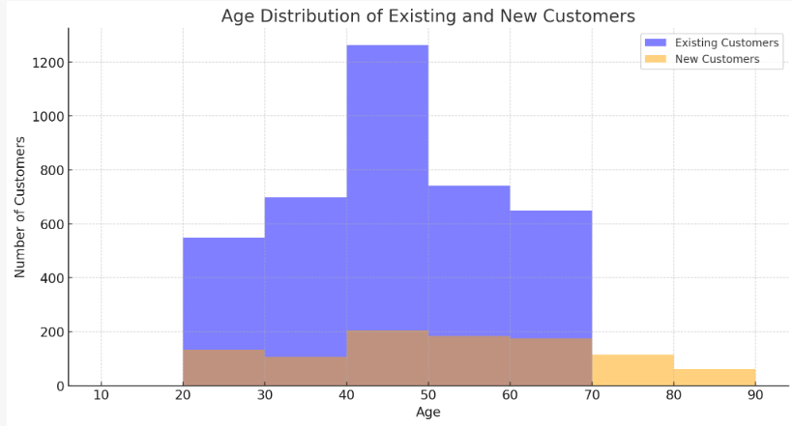
Data Exploration
Age Distribution
Most number of customers are from the age group of 40-50
While other age groups have the same average number of customers
Place any supporting images, graphs, data or extra text here.

Slide 6
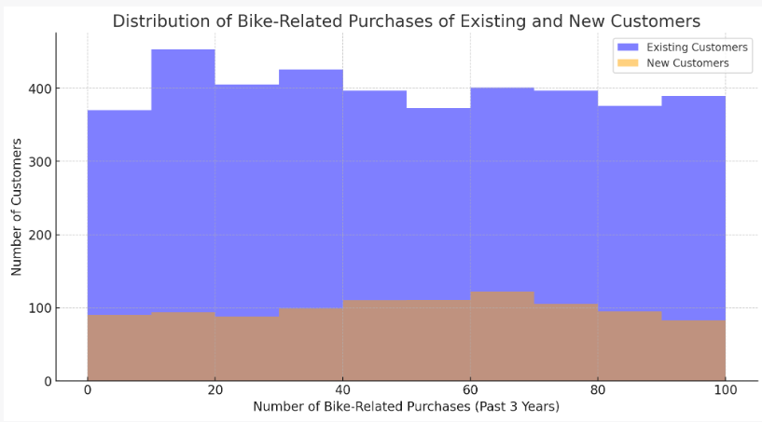
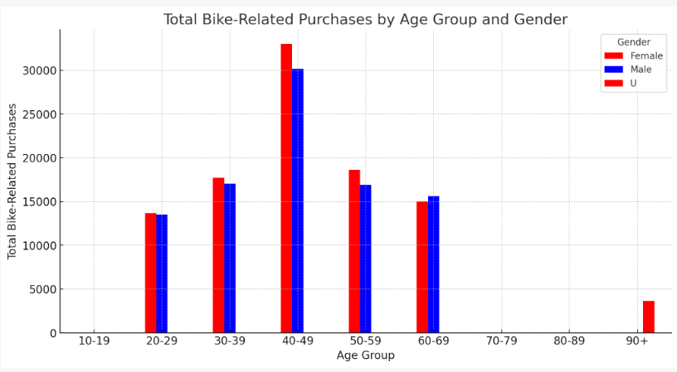
Data Exploration
While the Gender distribution is almost same, the age group 40-50 shows the highest number of sales.
Place any information about this point here.
Place any supporting images, graphs, data or extra text here.

Slide 7
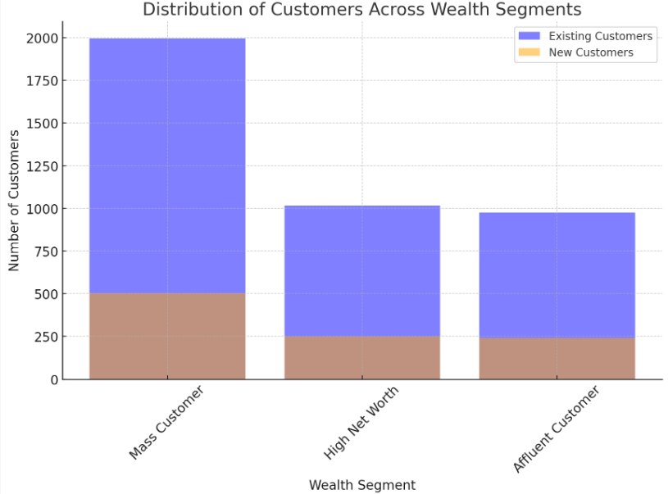
Data Exploration
Distribution across wealth segments
The mass customer is the target market due to the highest volume of customers
Place any supporting images, graphs, data or extra text here.

Slide 8
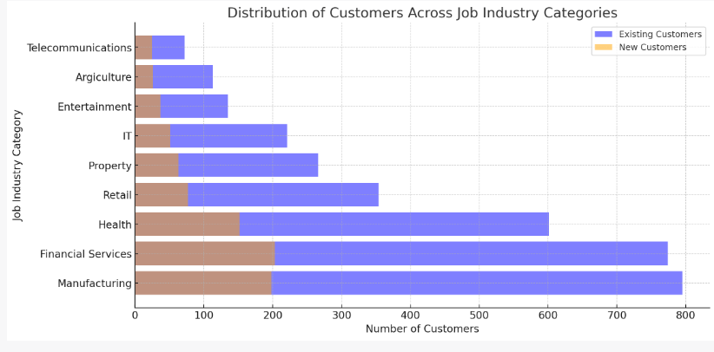
Data Exploration
Customers by Job industries
The top three industries with the most customers being health,
financial services and manufacturing
Place any supporting images, graphs, data or extra text here.

Slide 9
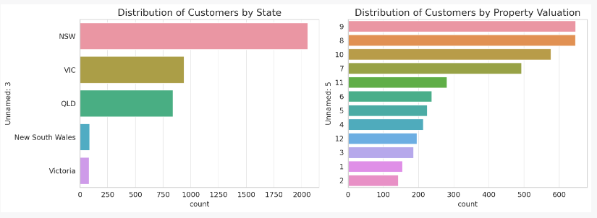
Data Exploration
Customers by Location
-Most customers are located in New South West, followed by Victoria and Queensland
-Most number of customers are those with the highest property valuation
Place any supporting images, graphs, data or extra text here.

Slide 10
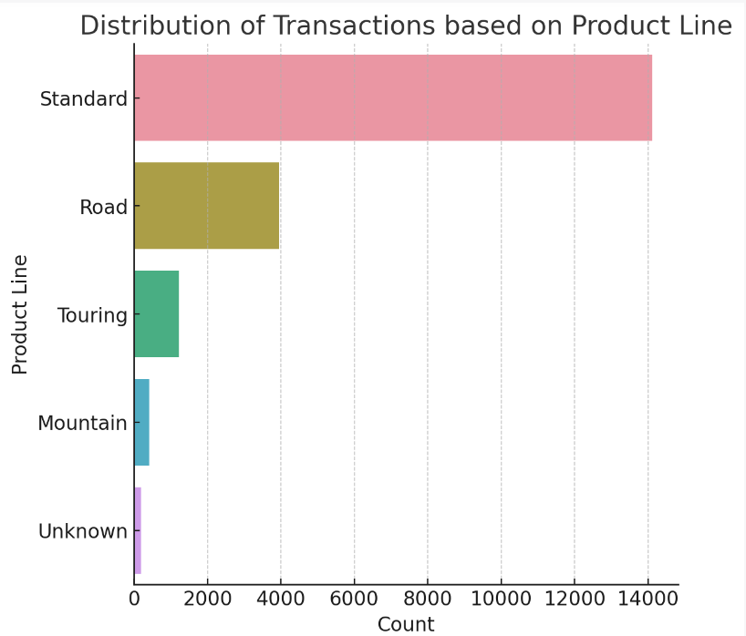
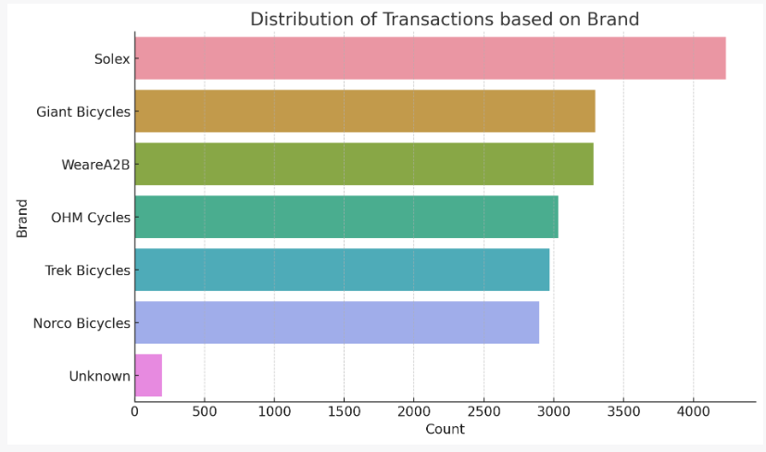
Data Exploration
Customers by Job industries
The Standard product range is the most sold product line
Place any supporting images, graphs, data or extra text here.

Slide 11
Model Development
Process
Data Used:
Customer Demographic: Information like age, gender, and job industry category.
Customer Address: Details like state and property valuation.
Transactions: Past transaction data was used but was not directly involved in the clustering of new customers.

Slide 12
Model Development
Process
Steps:
1. Data Preparation:
Handling Missing Values: Missing values in important columns were either filled with the mean (for numerical data) or the mode (for categorical data).
Encoding Categorical Variables: Categories were turned into numerical labels so that they could be used in the model.
Feature Scaling: The data was standardized to bring all the variables to a similar scale.
2. Feature Selection:
Important features like age, property valuation, and other demographic information were selected for clustering.

Slide 13
Model Development
Process
Steps:
3. Optimal Number of Clusters:
The Elbow Method was used to find the optimal number of clusters. The point where the within-cluster sum of squares (WCSS) starts to diminish is considered the "elbow", and it was found to be at 3 clusters.
4. Model Building:
A KMeans clustering model was then trained on the scaled and prepared data.
Each new customer was assigned to one of the 3 clusters.

Slide 14
Model Development
Process
Steps:
Data Used:
5. Cluster Analysis:
Various attributes of the clusters were analyzed. This included looking at the distribution of age, gender, job industry, wealth segment, and state within each cluster.

Slide 15
Note: The data and information in this document is reflective of a hypothetical situation and client. This document is to be used for KPMG Virtual Internship purposes only.
Interpretation
Marketing Strategy:
Based on the cluster characteristics, the following strategies were suggested:
Cluster 0: Focus on younger individuals, offer student discounts, and target people in manufacturing and financial services.
Cluster 1: Target middle-aged individuals, offer family packages, and focus on people in the health sector.
Cluster 2: Target older individuals, offer senior citizen discounts, and focus on people in the health and retail sectors.
Outcome:
The model successfully segmented the new customers into 3 distinct clusters, and a targeted marketing strategy was devised for each group.

